Slide 1

DATA STRUCTURES & ALGORITHMS CASE STUDY
Real-Time Fraud Detection System
Leveraging Advanced Data Structures for Financial Security.
Team Members:
Bharath . G (CB.SC.U4CSE24005)
Nikhilraj Letha (CB.SC.U4CSE24026)
Sandu Brahma Varun Teja (CB.SC.U4CSE24045)
Santhosh V (CB.SC.U4CSE24047)

Slide 2






Chapter 1
Core Data Structures Utilized
Our system integrates eight fundamental data structures, each serving a critical role in pattern matching, risk scoring, and behavioral analysis for real-time fraud detection.
Bloom Filter
Trie (Prefix Tree)
Fast, probabilistic membership testing for fraud patterns (O(k)).
Efficient deterministic pattern matching for known fraud signatures (O(m)).
Hash Table
Deque
Constant-time user profile lookups and transaction logging (O(1) average).
Implements sliding window for recent transaction tracking (O(1) append/pop).
Min/Max Heap
Graph (Adj. List)
Priority queue for tracking high-risk users (O(log n) insertion).
Models transaction relationships to identify fraud networks (O(1) edge insert).

Slide 3

Chapter 2: Project Overview
Key Features of the Detection System
The system analyzes transaction patterns, user behavior, and statistical anomalies to calculate fraud risk scores and flag suspicious activities.
Multi-layered Pattern Detection
Behavioral Risk Scoring
Combines Bloom Filter (fast screening) and Trie (precise verification) for robust fraud pattern recognition.
Calculates composite risk based on Velocity, Amount Deviation, Account Age, and Large Transaction flags.
Transaction Network Analysis
Priority-based Review
Uses a directed graph to model user-to-user transfers, identifying money laundering and coordinated fraud rings.
Manages fraud cases using a Max-Heap for top 10 riskiest users and a FIFO Queue for systematic case review.

Slide 4
Why These Data Structures?
Each structure is selected for its optimal time complexity, ensuring real-time performance and efficient resource management.
Bloom Filter: O(k) membership testing for screening millions of transactions without high memory usage.
Heap: Maintains top risky users in O(log n) time, faster than sorting the entire user base.
Trie: O(m) deterministic matching; supports prefix matching for partial pattern detection.
Graph (Adj. List): O(1) edge insertion, critical for modeling transaction flow in real-time.
Hash Table: Critical for O(1) user profile lookup in high-throughput systems.
Binary Search: Enables O(log n) percentile calculation for contextualizing risk scores.
Deque: Superior for sliding windows due to O(1) complexity at both ends, preventing memory bloat.
Queue: Ensures fair, sequential processing of flagged fraud cases (FIFO).

Slide 5
Chapter 5
Complexity Analysis: Time Efficiency
The system is designed for real-time processing, with most core operations achieving constant or logarithmic time complexity.
User Lookup
O(1)
Hash table access
Pattern Check (Bloom)
O(k)
k = hash functions (constant)
Pattern Check (Trie)
O(m)
m = pattern length (short)
Queue/Deque Operations
O(1)
Enqueue, Dequeue, Append, Pop
Risk Heap Insert
O(log n)
Efficient priority management
Deviation Score
O(n)
n = sliding window size (dominant factor)
Overall Per-Transaction Complexity: O(n), dominated by the statistical analysis over the fixed-size sliding window.

Slide 6









Space Complexity: Linear Scaling
The system exhibits linear space scaling O(u) with respect to the number of users, making it predictable and manageable for production deployment.
User Profiles
Sliding Windows
O(u) - Hash Table storage.
O(u × w) - Dominant factor. Bounded memory per user.
Bloom Filter
Transaction Graph
O(m) - Fixed size, independent of pattern count.
O(V + E) - Scales with users and transfers.
For 10,000 users, the total memory usage is approximately 284 MB, with sliding windows accounting for over 50% of the total memory footprint.

Slide 7
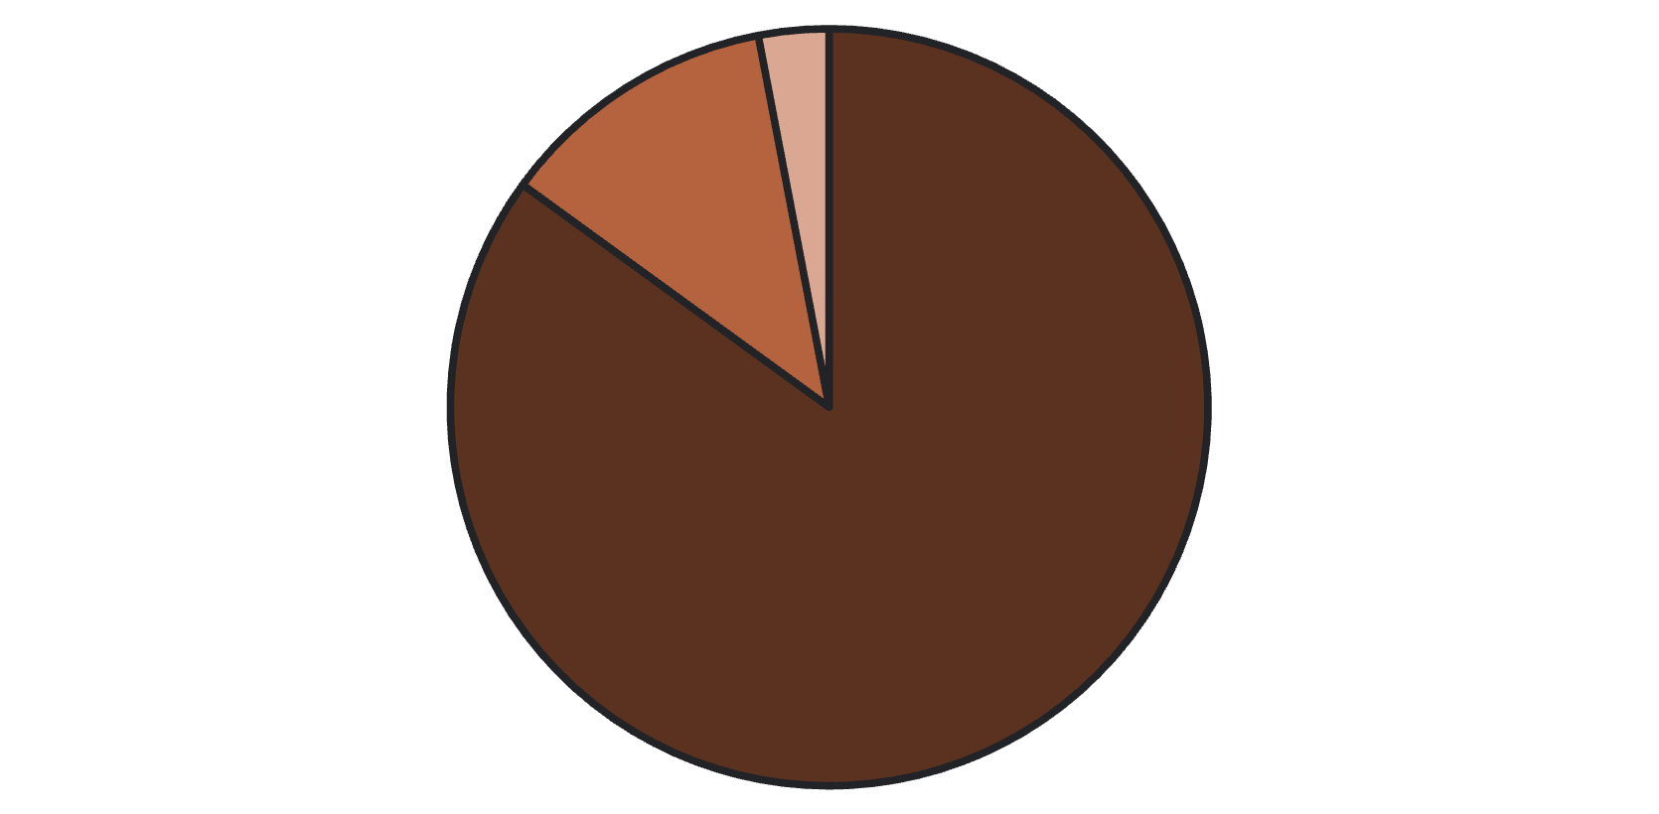
Chapter 7: Results
Performance Metrics & Validation
Testing on 10,000 transactions confirmed high accuracy and real-time processing capability.
0.003
333
Risk Distribution
Avg. Processing Time
Transactions per Second
Seconds per transaction, enabling real-time analysis.
System throughput capacity.
98.9%
94.7%
Accuracy
F1-Score
Low Risk (< 0.3)
Medium Risk (0.3 - 0.7)
High Risk (> 0.7)
Overall system accuracy on test data.
Balanced measure of precision and recall.

Slide 8

Chapter 8 & 9
Advantages and Trade-offs
The system's strength lies in its multi-layered approach, but it faces inherent limitations due to the nature of the data structures used.
Technical Advantages
Key Limitations
Multi-layered Detection: Combines probabilistic (Bloom) and deterministic (Trie) methods.
Bloom Filter: May produce false positives (2-3% of clean transactions).
Real-time Performance: O(n) per-transaction complexity.
Trie: Only supports exact pattern matching; cannot detect variations.
Memory Efficient: Bloom Filter reduces memory footprint by 90% compared to full hash sets.
Sliding Window: Fixed context; misses long-term trends and suffers from the "cold start" problem for new users.
Automated Prioritization: Heap-based ranking focuses review resources on highest risks.
Risk Scoring: Uses linear weighting and hard-coded thresholds, lacking adaptive learning.

Slide 9





Chapter 10
Future Enhancements & Scalability
To evolve into a production-ready system, future work will focus on integrating machine learning and distributed systems for enhanced features and performance.
ML Integration
Use supervised learning for dynamic weight adjustment and neural networks for complex pattern recognition.
Distributed Systems
Implement Kafka Streams for real-time processing and Cassandra/Redis for scalable persistence and caching.
Advanced Data Structures
Explore Count-Min Sketch for frequency estimation and Skip Lists for dynamic percentile calculation.
Enhanced Features
Add Geolocation Analysis (impossible travel) and Graph Algorithms (PageRank) for deeper insights.

Slide 10
Chapter 14
Conclusion: Bridging Theory and Practice
This project demonstrates that computer science fundamentals—data structures and algorithms—form the foundation of modern financial security systems.
Key Achievement
Successful integration of eight data structures for a comprehensive, multi-layered fraud detection architecture.
Lesson Learned
Choosing the right data structure for each operation is critical; trade-offs between speed, space, and accuracy are inevitable.
Real-World Impact
Applicable to banking, e-commerce, and cryptocurrency monitoring, demonstrating practical security solutions.
Educational Value
Illustrates how theoretical DSA concepts translate directly into efficient, scalable, and accurate real-world systems.
"DSA knowledge is not just for coding interviews, but is essential for solving real-world problems at scale."

Slide 11
References
[1] Bloom, B. H. (1970). Space/time trade-offs in hash coding with allowable errors. Com munications of the ACM, 13(7), 422-426.
[2] Cormen, T. H., Leiserson, C. E., Rivest, R. L., & Stein, C. (2009). Introduction to Algorithms (3rd ed.). MIT Press.
[3] Knuth, D. E. (1998). The Art of Computer Programming, Volume 3: Sorting and Searching (2nd ed.). Addison-Wesley.
[4] Sedgewick, R., & Wayne, K. (2011). Algorithms (4th ed.). Addison-Wesley.
[5] Skiena, S. S. (2008). The Algorithm Design Manual (2nd ed.). Springer.
[6] Federal Trade Commission. (2020). Consumer Sentinel Network Data Book 2020. Re trieved from https://www.ftc.gov
[7] Dal Pozzolo, A., et al. (2019). Credit Card Fraud Detection: A Realistic Modeling and a Novel Learning Strategy. IEEE Transactions on Neural Networks and Learning Systems. Fraud Detection System 33
[8] Akoglu, L., Tong, H., & Koutra, D. (2018). Graph-based Anomaly Detection and Description: A Survey. Data Mining and Knowledge Discovery, 29(3), 626-688.
[9] Python Software Foundation. (2023). Python Documentation: Data Structures. Re trieved from https://docs.python.org

